Slide 1

Surrey County Council Transformation Programme
Summary: May 2019

Slide 2
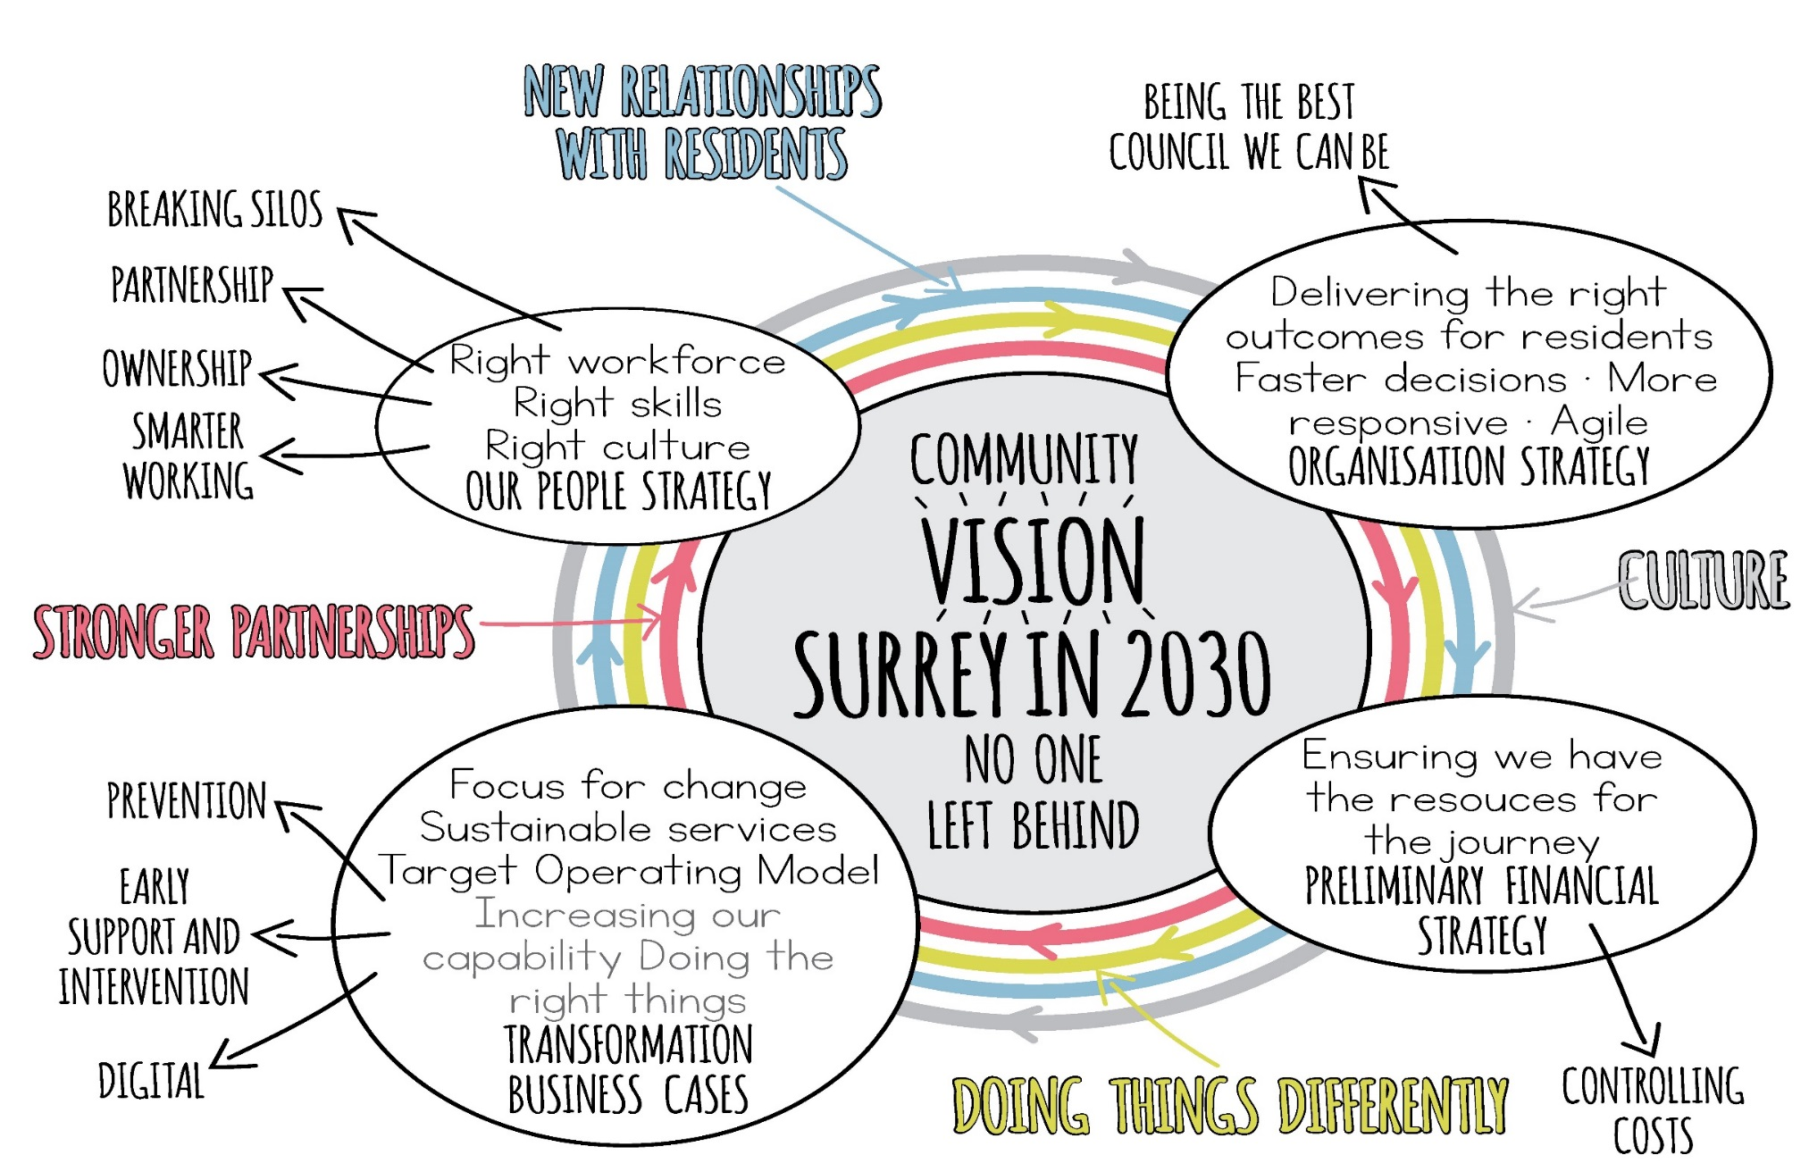
Delivering our shared vision for Surrey
In 2018 Surrey County Council published a set of connected strategies setting out our ambition for the type of Council we want to be and our role in delivering the Community Vision for Surrey 2030. These reflected the need to change and radically improve the council’s culture, approach and performance, putting residents’ current and future needs first and working better in partnership to achieve this.

Slide 3
Why we are changing
We have to continue our work to get the council’s finances on to a sustainable footing – this is essential if we are to deliver our ambitions for Surrey residents. Other changes and improvements we are making go deeper and wider than just finance and reflect the changing needs, hopes and expectations of our residents.
Aims:
We have set up a core programme of projects across the council to help us achieve this – but importantly our change and improvement work is not just a project, programme or one-off initiative – it is the right way of doing things to make a real difference to our residents and underlies all our work.
Residents
Give residents more power, support and opportunities to help themselves and each other
Prevention
Focus relentlessly on prevention work to address residents’ issues earlier and before they get worse
Performance
Deal with poor performance and quality so that vital services are delivered where they are needed most
Partnership
Work better with our partners across the county, co-ordinating, convening and collaborating to secure better outcomes for the residents we serve
Staff
Employ and grow the best staff and give them the training and technology they need to do an excellent job

Slide 4
Overview of transformation projects underway
TRANSFORMING SERVICES FOR PEOPLE
Family Resilience - Transforming Services so that all children in Surrey receive the right help at the right time to enable them and their families to face future life challenges independently
SEND Transformation - Transforming SEND services to deliver improved outcomes for children and young people with special educational needs and disabilities whilst ensuring the service is financially sustainable
Adult Social Care Market Management - Working closely with our providers and developing improved commissioning capacity to manage the costs of care within available resources
Practice Improvement Adult Social Care - A new model of care that supports people to live independent and fulfilling lives
Adult Social Care Integrated Models of Care - Delivering a new model of care to support people to live independently, delay the need for care and support, prevent admission to hospital, and support hospital discharge through collaborative working
All Age Learning Disabilities - Enabling residents to access quality local provision closer to home, be more independent, and have more choice and control in their own lives

Slide 5
Overview of transformation projects underway
TRANSFORMING PLACE SERVICES
Highways Transformation - Ensuring that our highways and transport, environment, fire and rescue and trading standards services work together effectively to deliver good customer service, value for money and effective protection for our communities
Waste - Delivering a service that continues to follow best practice, enables non-statutory waste services to be self-sufficient, and places a core focus on recycling
Libraries and Cultural Services - Modernising Libraries and Cultural Services so they can remain at the heart of communities and support lifelong learning
Surrey Fire and Rescue - Enabling communities to be more resilient through our increased focus on Protection & Prevention activities. Reacting to recent inspection results to ensure a more sustainable, efficient and effective Fire and Rescue Service

Slide 6
Overview of transformation projects underway
BECOMING A MODERN COUNCIL
Asset and Place Strategy - Effective joint working with partners on use of assets and resources for service delivery and on plans for specific places across Surrey, including repurposing of existing assets for other uses
Agile Workforce - Supporting residents with a workforce that works from anywhere, with anyone
Digital - Helping Surrey to become a digital council through the delivery of digital technologies, enabling service transformation, cost reduction and improved demand management
Customer Experience: Develop a 'single front door', providing a consistent, high quality resident focused service that’s ‘digital by design’
Moving Closer to Residents - Moving staff out of County Hall in Kingston to be closer to our residents. This will be accompanied by rollout of new ways of working, including the culture change and technology to enable more agile working

Slide 7
Overview of transformation projects underway
IMPROVING CORE CAPABILITIES
Finance Transformation - Establishing a financially sustainable County Council with a strong culture of financial management, accountability and evidence-based decision-making across the organisation
Orbis Value for Money - Ensuring that the Orbis support functions partnership with East Sussex CC and Brighton and Hove City Council is meeting the needs of partner councils, delivering savings and adapting to support transformation
Performance management and insight - Developing a shared ‘single view of the truth’ across our data, providing consistent view of how our activity is helping to achieve our ambitions for residents
Spans of Control - Creating a consistent organisation that has strong accountability and increased empowerment of staff
Fees and Charges - Making non-essential services self-sufficient and generating income to reduce cost pressures on critical services

Slide 8
Overview of transformation projects underway
SHAPING FUTURE SERVICES
Accommodation with Care and Support - Meeting and managing the changing demands of people with care and support needs, while enabling residents to retain independence for longer and have an improved quality of life
Commissioning - Driving a coherent commissioning approach that enables the council to identify and realise new benefits and opportunities for Surrey’s residents and communities
Strategic Transport - Reimagining passenger transport in Surrey, understanding why people travel across the county and the potential options for supporting this differently in the future

Slide 9
The financial context
The transformation programme will deliver £52m of direct savings in 2019/20 (as part of overall Council savings of £82m) and contain significant cost pressures where demands for services are increasing (e.g. SEND, Adult Social Care). The transformation projects will then contribute an additional £28m savings in 2020/21.
The total direct savings across the programme to 2021 include:
£30m Adult Social Care
£33m Children, Families, Lifelong Learning and Cultural services
£13m Waste, Highways & Fire services
£4m Changing our ways of working

Slide 10
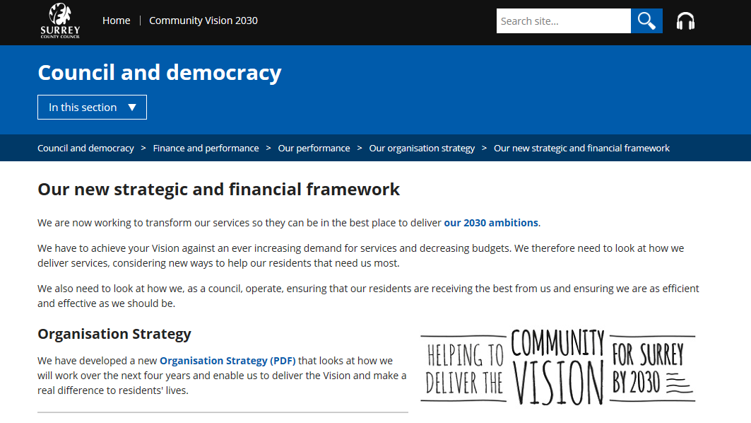
Find out more
https://www.surreycc.gov.uk/council-and-democracy/finance-and-performance/our-performance/our-organisation-strategy/communications-and-engagement-strategy-2014-19
michael.coughlin@surreycc.gov.uk – Executive Director for Transformation, Partnerships and Prosperity
marie.snelling@surreycc.gov.uk – Director of Transformation

